Slide 1

RESTAURANT MANAGEMENT SYSTEM
Rmk college of engineering and technology
Team members:
Cherin.M
Ayisha begum.S PROJECT GUIDE:
Chitra banu.S SANDHIYA.R
Manasa.G

Slide 2
OBJECTIVE
The main objective of this application is an efficient management of details of Food item, cart, category, order, customer.

Slide 3
DISADVANTAGES OF EXISTING SYSTEM
Time consuming process.
Need of paper for printing menu cards.
Need more manpower.
More amount of manual work to be accomplished.
Chances of serving wrong dishes to customers.
Lacks customer satisfaction.
Daily Updates are not possible through printed menu cards

Slide 4
PROPOSED SYSTEM
The proposed system helps in elimination or the reduction of the manual works and the reduction of money spent on the man power. The proposed system helps the administration to operate and manage their resources smoothly and efficiently.
In these system we have a QR Code in the menu card in each table of the restaurant. For more details about the food stuff you just scan the QR Code. After the QR Code scanning the customer gets into our website home page displaying the menu items and their respective price.

Slide 5
ADVANTAGES OF PROPOSED SYSTEM
Decreases the load of the person involved in the existing manual system.
Accuracy in work.
Work becomes very speedy.
Easy to update information.
It contains better storage capacity.
It tracks all the information of category, orders etc.
Manages and integrates all the information of the customers.
Editing, adding and deleting of food items is easy and cost free.

Slide 6
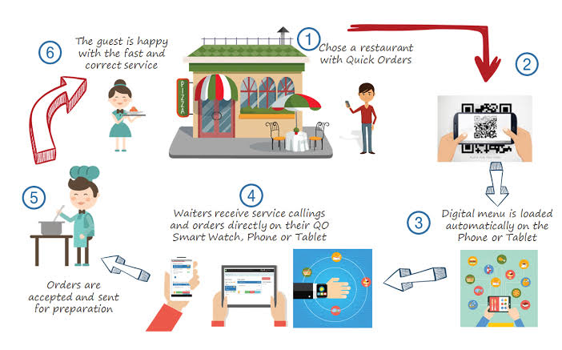
ARCHITECTURE DIAGRAM

Slide 7
MODULES
Order module: It contains all thefunctionalities related to the Order Delivery module: It manages all theoperations related to Delivery•
Payment module : Manages the Payment related functionalities•
Customer module: This modulemanages Customer functionalitiesCategory module: Category modules contains all the CRUD operations related to Category•
Sales module: Sales module contains all the required functions which include adding, viewing, deleting and updating Sales lists.

Slide 8
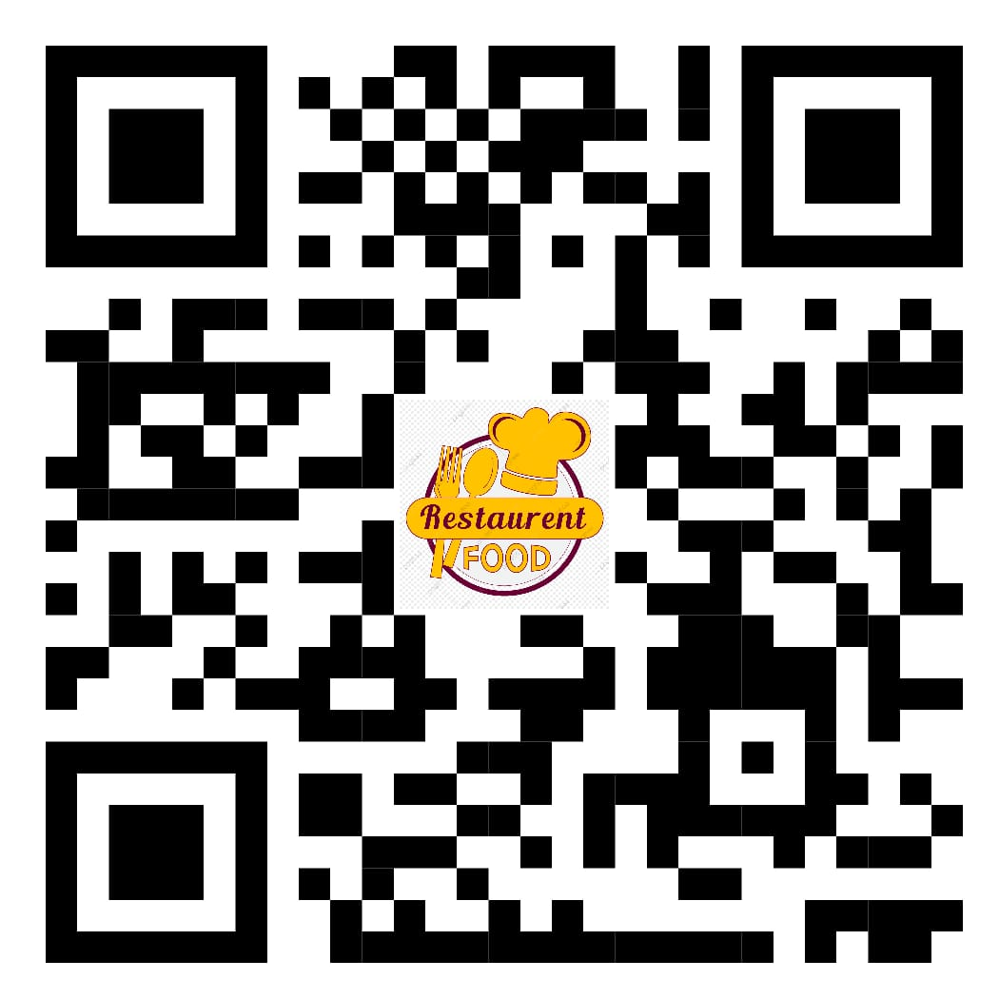
SCREENSHOT OF THE QR CODE
Url link for QR code:
https://sherinsofiak.wixsite.com/restaurantmanagement

Slide 9
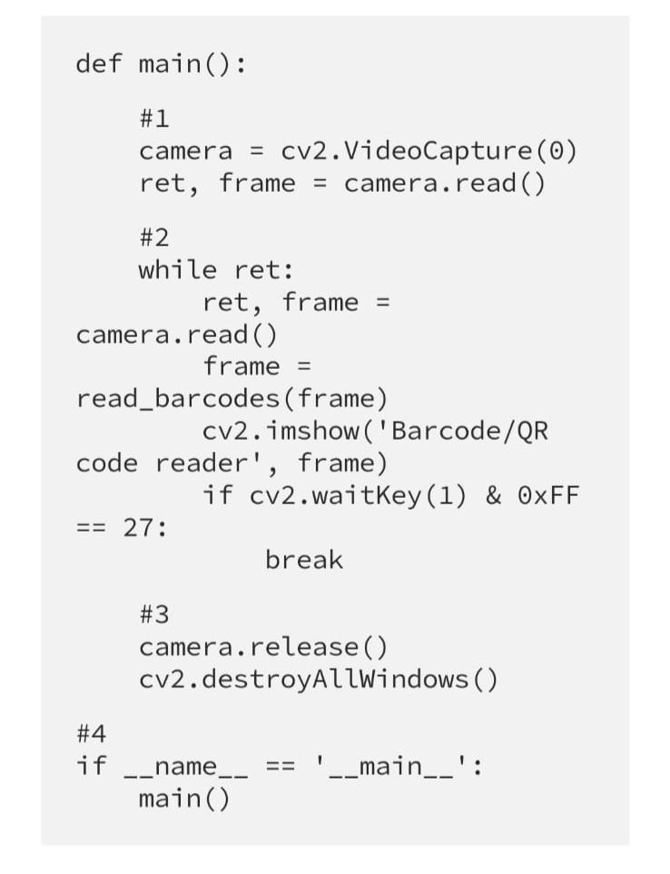
CODE FOR QR CODE

Slide 10
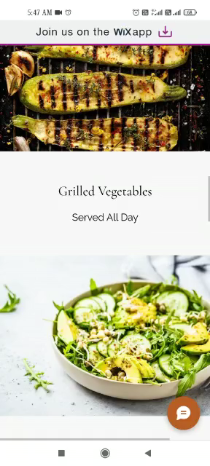
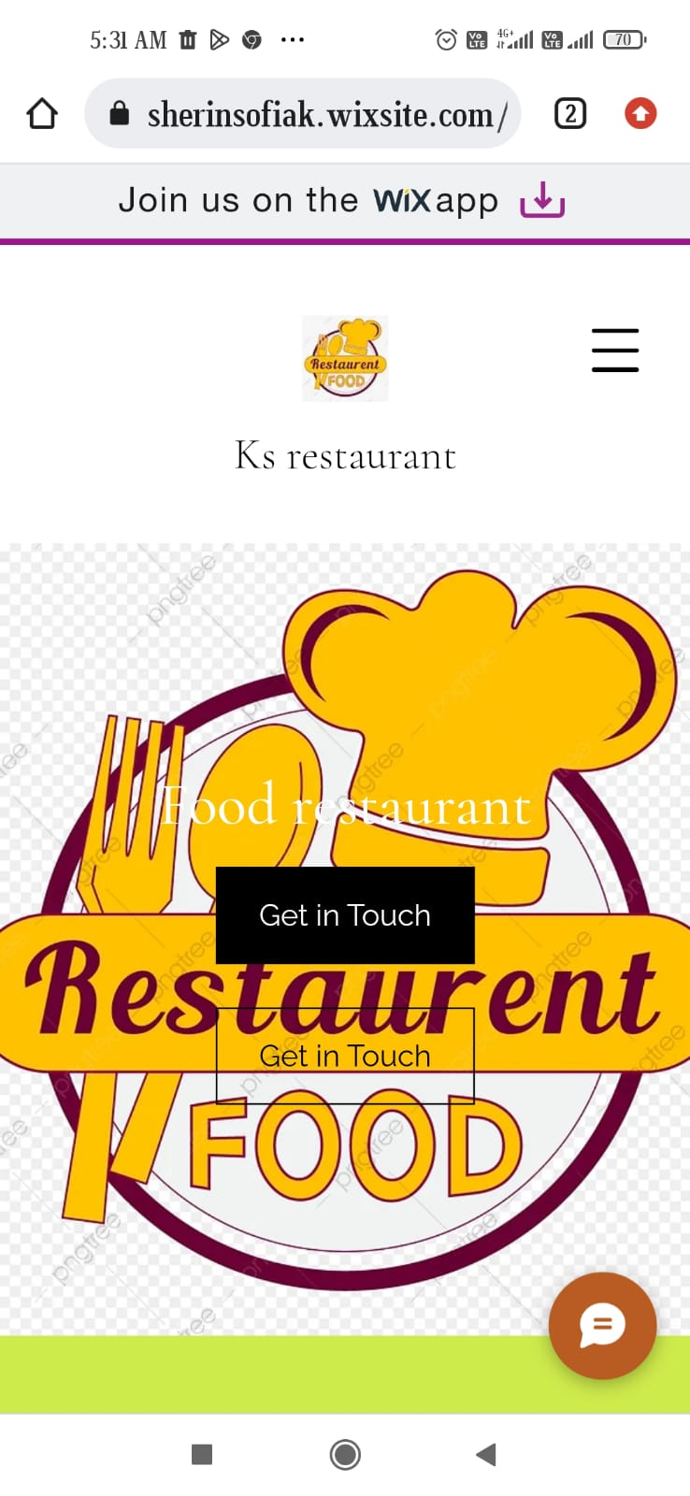
WEBSITE USING QR CODE

Slide 11
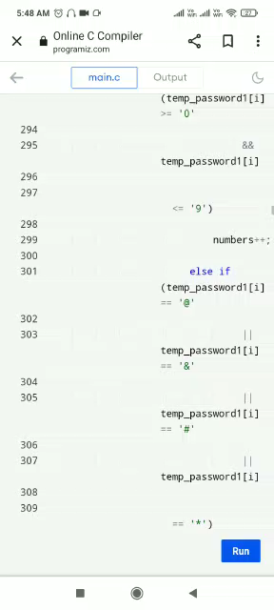
Code for Restaurant management system

Slide 12
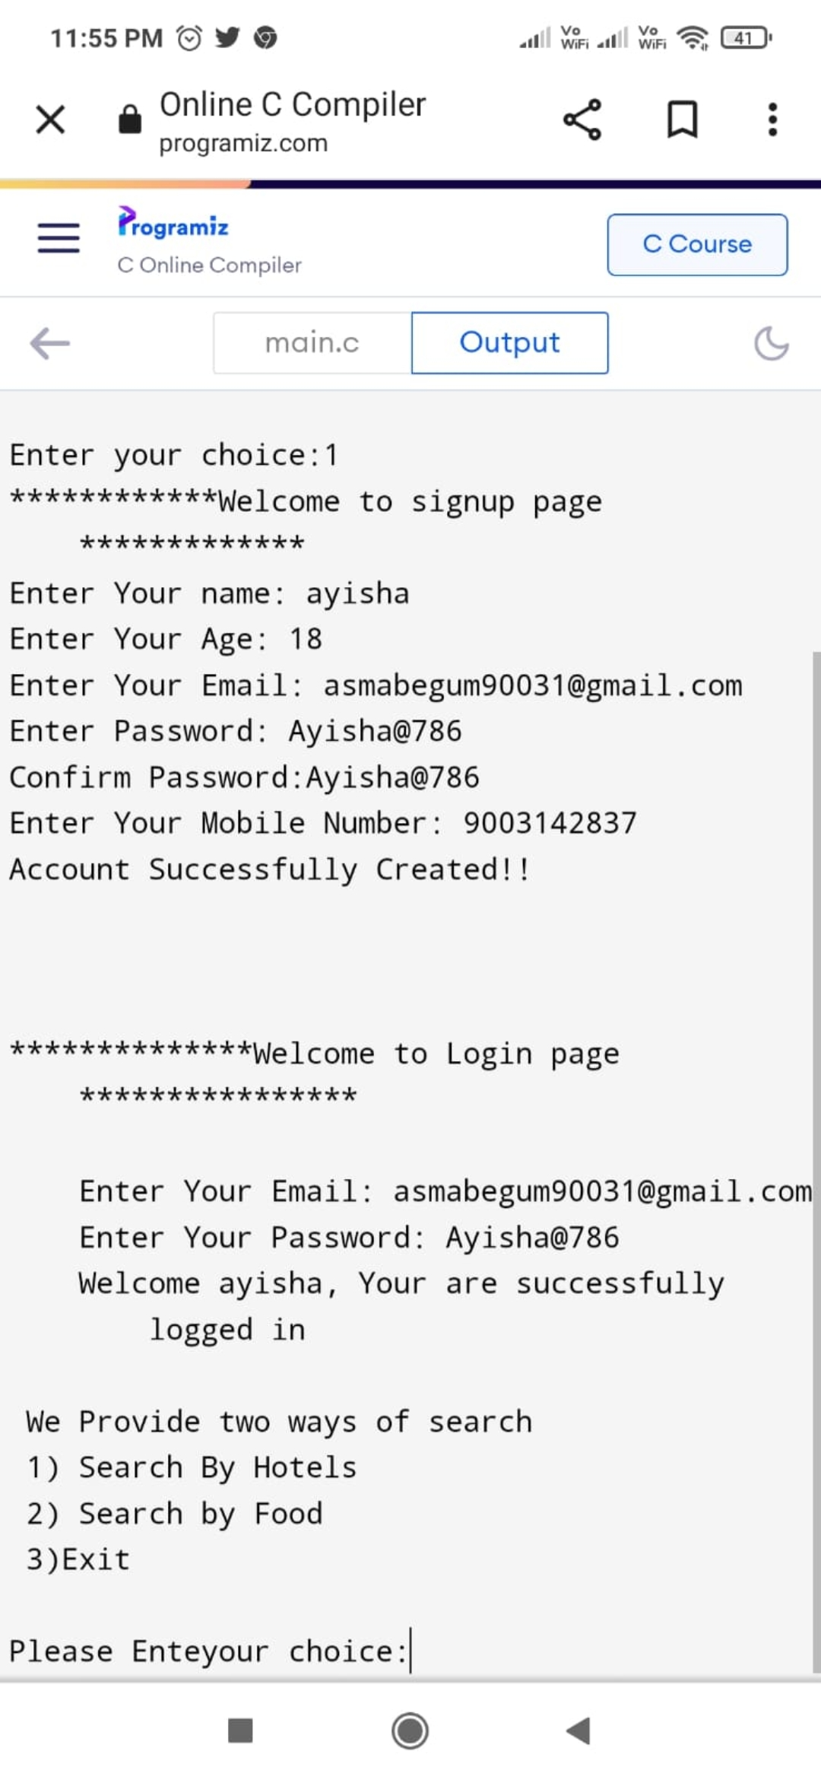
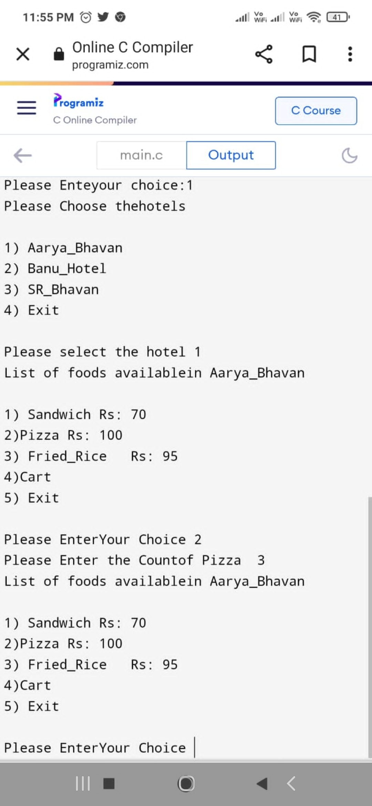
OUTPUT

Slide 13
THANK YOU

